Slide 1
Introduction to Sockets (part 1)
IP, ICMP, UDP, TCP header format, servers, byte ordering, socket file descriptors, POSIX data types and functions, useful tools
Chapters 1,2 and 3.

Slide 2
IP Protocol Suite
Application
Application
BGP, DHCP, DNS, FTP, HTTP, HTTPS,
IMAP, LDAP, MGCP, NNTP, NTP, POP
ONC/RPC, RTP, RTSP, RIP, SIP, SNMP, SMTP,
SSH, Telnet, TLS/SSL, XMPP,….
Presentation
Session
Transport
TCP/UDP
TCP
UDP
SCTP
mTCP
DCCP
RSVP
ICMP IGMP
Network
IP
IPv4
IPv6
Data Link
Ethernet/etc…
OSI
Reference Model
TCP/IP
Model

Slide 3
Internet Protocol
Two versions, v4 and v6.
(Odd numbers are for research/testing, i.e. should not be seen in the wild) .
IPv4,
Request for Comments (RFC) 791 (Sept. 1980).
Internet Standard (STD) 5.
IPv6,
RFC 8200 (…. July. 2017).
Internet Standard
32-bit address space
Fragments
128-bit address space
No Fragments

Slide 4
IP Principle
Unreliable and connectionless datagram delivery service.
Unreliable: No guarantees that a datagram will be successfully delivered to its destination.
IP provides Best Effort service.
Connectionless: IP will not maintain state information about successive datagrams. Each datagram is handled as an independent entity.

Slide 5
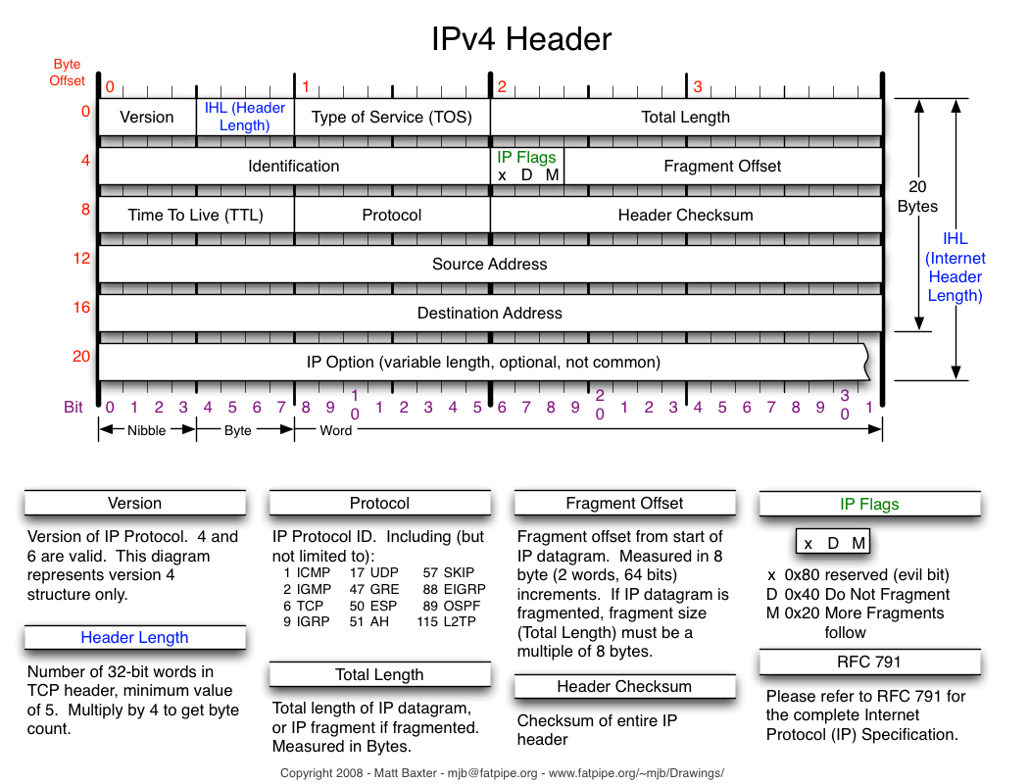

Slide 6
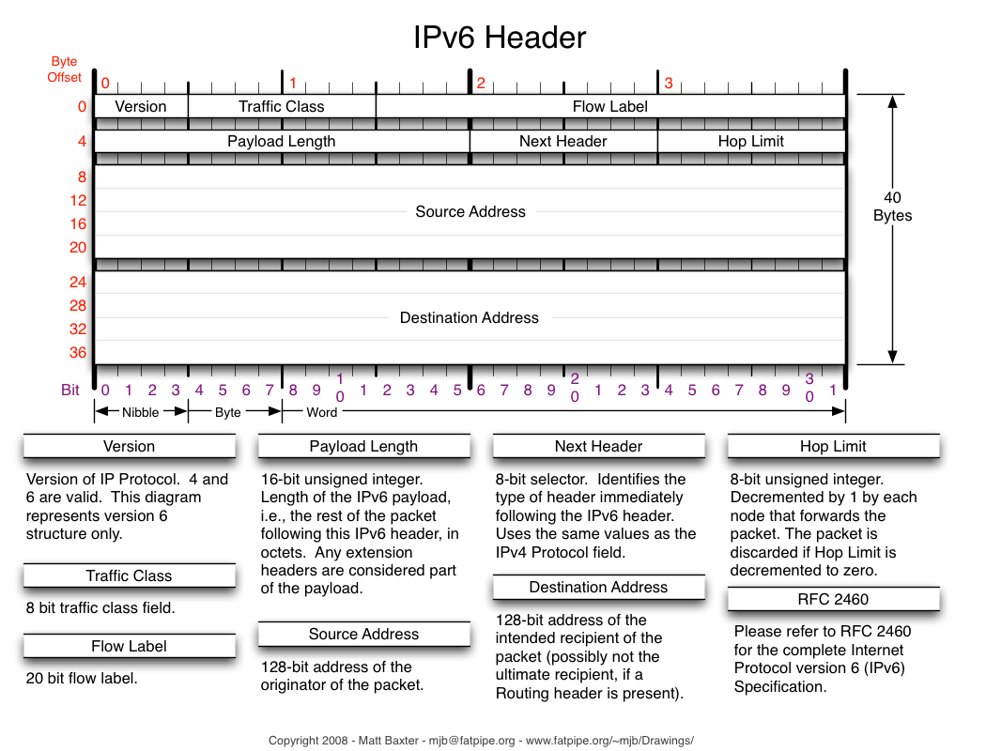

Slide 7
Addressing
Version 4
140.252.1.29
194.47.151.182
Version 6
2001:0db8:85a3:0000:0000:8a2e:0370:7334
2001:db8:85a3:0:0:8a2e:370:7334
2001:db8:85a3::8a2e:370:7334

Slide 8
Version 6 – Simplified Notation
2001:0db8:85a3:0000:0000:8a2e:0370:7334
/0{1,4}/0/g -- /^0//g -- /0$//g --
2001:db8:85a3:0:0:8a2e:370:7334
/^0$//g -- /:{3,}/::/g
2001:db8:85a3::8a2e:370:7334

Slide 9
Subnet Mask
Address + subnet mask => net ID & host id
A & MASK => NetID
A &!MASK => HostID
Two notations (examples)
“Classbased” 255.255.255.0
“Classless” /24

Slide 10
Subnetting
Separate Network and Host parts
Network Address
Host ID
Network Address
Host ID
Network Address
Host ID

Slide 11
Subnet Example: 192.168.0.1/26
Address: 192.168.0.1 11000000.10101000.00000000.00 000001
Netmask: 255.255.255.192 = 26 11111111.11111111.11111111.11 000000
Wildcard: 0.0.0.63 00000000.00000000.00000000.00 111111
Network: 192.168.0.0 11000000.10101000.00000000.00 000000
Broadcast: 192.168.0.63 11000000.10101000.00000000.00 111111
HostMin: 192.168.0.1 11000000.10101000.00000000.00 000001
HostMax: 192.168.0.62 11000000.10101000.00000000.00 111110
Hosts/Net: 62
Network = Address & Mask
Host Min = Network Address + 1
Wildcard = !Netmask
Broadcast = Upper Network Address
Host Max = Broadcast - 1

Slide 12
Subnet Example: 194.47.151.65/25
Address: 194.47.151.65 11000010.00101111.10010111.0 1000001
Netmask: 255.255.255.128 = 25 11111111.11111111.11111111.1 0000000
Wildcard: 0.0.0.127 00000000.00000000.00000000.0 1111111
Network: 194.47.151.0 11000010.00101111.10010111.0 0000000
Broadcast: 194.47.151.127 11000010.00101111.10010111.0 1111111
HostMin: 194.47.151.1 11000010.00101111.10010111.0 0000001
HostMax: 194.47.151.126 11000010.00101111.10010111.0 1111110
Network = Address & Mask
Host Min = Network Address + 1
Wildcard = !Netmask
Broadcast = Upper Network Address
Host Max = Broadcast - 1

Slide 13
Networks
192.168.0.4
& 255.255.255.0
192.168.0.0
192.168.0.5
192.168.0.0/24
Grouping of Hosts
Simplifies Routing/Forwarding
Host
192.168.0.254
Host
Host
192.168.0.4
192.168.0.254
& 255.255.255.0
192.168.0.0

Slide 14
Networks
192.168.0.5
Host
192.168.0.0/24
192.168.0.254
Host
192.168.1.0/24
192.168.1.30
Router
Host
192.168.0.x
192.168.1.y
Host
192.168.0.4
192.168.1.30 & 255.255.255.0 = 192.168.1.0 != 192.168.0.0

Slide 15
Networks
192.168.3.0/24
Routing Table
192.168.3.0/24 local via 192.168.3.y
192.168.1.0/24 local via 192.168.1.x
192.168.0.0/24 remote via 192.168.1.y
192.168.2.0/24 remote via 192.168.1.z
192.168.0.5
Router
Host
192.168.0.0/24
192.168.0.254
Host
192.168.1.0/24
192.168.1.30
Router
192.168.1.x
Host
192.168.0.x
192.168.1.y
192.168.2.0/24
Router
Host
192.168.1.z
192.168.0.4
192.168.2.y
Routing Table
192.168.0.0/24 local via 192.168.0.x
192.168.1.0/24 local via 192.168.1.y
192.168.3.0/24 remote via 192.168.1.x
192.168.2.0/24 remote via 192.168.1.z
Routing Table
192.168.2.0/24 local via 192.168.2.y
192.168.1.0/24 local via 192.168.1.z
192.168.3.0/24 remote via 192.168.1.x
192.168.0.0/24 remote via 192.168.1.y

Slide 16
Internet -- Inter connection of Networks
Router
192.168.x.0/24
192.168.5.0/24
192.168.x.0/24
192.168.x.0/24
Router
192.168.4.0/24
IP Router
Forwards IP datagrams
Minimum two Addresses on/in two different networks
Routing Table
Router
192.168.x.0/24
Router
192.168.3.0/24
Router
192.168.x.0/24
Router
Router
192.168.x.0/24
192.168.0.0/24
192.168.1.0/24
192.168.x.0/24
Router
192.168.2.0/24
Router

Slide 17

Subnet, Forwarding and Gateway
To: 192.168.1.14
Forwarding Table
Destination Gateway Genmask Flags Metric Ref Use Iface
0.0.0.0 192.168.1.1 0.0.0.0 UG 0 0 0 em1
192.168.1.0 0.0.0.0 255.255.255.0 U 0 0 0 br0
To: 8.8.8.8
192.168.1.0/24
Match!
Use!
192.168.1.14
& 255.255.255.0
192.168.1.0 <= NetID
192.168.1.12
192.168.1.14

Slide 18
Subnet, Forwarding and Gateway
Forwarding Table
Destination Gateway Genmask Flags Metric Ref Use Iface
0.0.0.0 192.168.1.1 0.0.0.0 UG 0 0 0 em1
192.168.1.0 0.0.0.0 255.255.255.0 U 0 0 0 br0
To: 8.8.8.8
192.168.1.0/24
No Match!
8.8.8.8 & 255.255.255.0
= 8.8.8.0 <= NetID
8.8.8.8 & 0.0.0.0
= 0.0.0.0 <= NetID
Match!
192.168.1.12
Internet
192.168.1.1

Slide 19
Intermediary Summary
IP v4 / v6
Networks / Subnetting
Forwarding / Routing

Slide 20
Network to Data link
Network
IP
Data Link
Ethernet
Tokenring/bus
FDDI
…..
OSI
Reference Model
TCP/IP
Model

Slide 21
Address Resolution Protocol (ARP)
Translate between Network and L2 address
10.1.0.59 ether b0:83:fe:bb:1d:8c C br0
10.1.0.53 ether 00:19:b9:12:79:32 C br0
194.47.151.112 ether d4:ae:52:ea:c9:30 C em1
194.47.151.65 ether 00:1b:53:99:53:ff C em1
10.1.0.62 ether 00:19:b9:20:c8:83 C br0
10.1.0.162 ether 54:9f:35:1f:c3:2a C br0
10.1.0.169 ether 08:00:27:30:ac:16 C br0
10.1.0.63 ether 00:19:b9:20:c7:48 C br0
10.1.0.42 ether 68:05:ca:24:45:36 C br0
194.47.151.126 ether 00:25:64:3b:cf:91 C em1

Slide 22
Address Resolution Protocol (ARP)
Send to 10.1.0.42
10.1.0.59 ether b0:83:fe:bb:1d:8c C br0
10.1.0.53 ether 00:19:b9:12:79:32 C br0
194.47.151.112 ether d4:ae:52:ea:c9:30 C em1
194.47.151.65 ether 00:1b:53:99:53:ff C em1
10.1.0.62 ether 00:19:b9:20:c8:83 C br0
10.1.0.162 ether 54:9f:35:1f:c3:2a C br0
10.1.0.169 ether 08:00:27:30:ac:16 C br0
10.1.0.63 ether 00:19:b9:20:c7:48 C br0
10.1.0.42 ether 68:05:ca:24:45:36 C br0
194.47.151.126 ether 00:25:64:3b:cf:91 C em1
Eth.dst
68:05:ca:24:45:36
Eth.src
34:17:eb:ea:df:9f
0x0800
IP.dst=10.1.0.42

Slide 23
Address Resolution Protocol (ARP)
Send to 10.1.0.46
10.1.0.59 ether b0:83:fe:bb:1d:8c C br0
10.1.0.53 ether 00:19:b9:12:79:32 C br0
194.47.151.112 ether d4:ae:52:ea:c9:30 C em1
194.47.151.65 ether 00:1b:53:99:53:ff C em1
10.1.0.62 ether 00:19:b9:20:c8:83 C br0
10.1.0.162 ether 54:9f:35:1f:c3:2a C br0
10.1.0.169 ether 08:00:27:30:ac:16 C br0
10.1.0.63 ether 00:19:b9:20:c7:48 C br0
10.1.0.42 ether 68:05:ca:24:45:36 C br0
194.47.151.126 ether 00:25:64:3b:cf:91 C em1
No match!

Slide 24

ARP
Broadcast: Who has 10.1.0.46
Tell: 34:17:eb:ea:df:9f
10.1.0.46
68:05:ca:24:45:46
…
10.1.0.42
10.1.0.17
10.1.0.48
10.1.0.52

Slide 25
ARP
To: 34:17:eb:ea:df:9f
10.1.0.46 is at
68:05:ca:24:45:46
10.1.0.46
68:05:ca:24:45:46
…
10.1.0.42
10.1.0.17
10.1.0.48
10.1.0.52

Slide 26
Address Resolution Protocol (ARP)
Send to 10.1.0.46
10.1.0.59 ether b0:83:fe:bb:1d:8c C br0
10.1.0.53 ether 00:19:b9:12:79:32 C br0
194.47.151.112 ether d4:ae:52:ea:c9:30 C em1
194.47.151.65 ether 00:1b:53:99:53:ff C em1
10.1.0.62 ether 00:19:b9:20:c8:83 C br0
10.1.0.162 ether 54:9f:35:1f:c3:2a C br0
10.1.0.169 ether 08:00:27:30:ac:16 C br0
10.1.0.63 ether 00:19:b9:20:c7:48 C br0
10.1.0.42 ether 68:05:ca:24:45:36 C br0
194.47.151.126 ether 00:25:64:3b:cf:91 C em1
10.1.0.46 ether 68:05:ca:24:45:46 C br0

Slide 27
Short overview of Transport Layer and Protocols

Slide 28
Internet Main Transport Protocols
ICMP
UDP
TCP
….

Slide 29
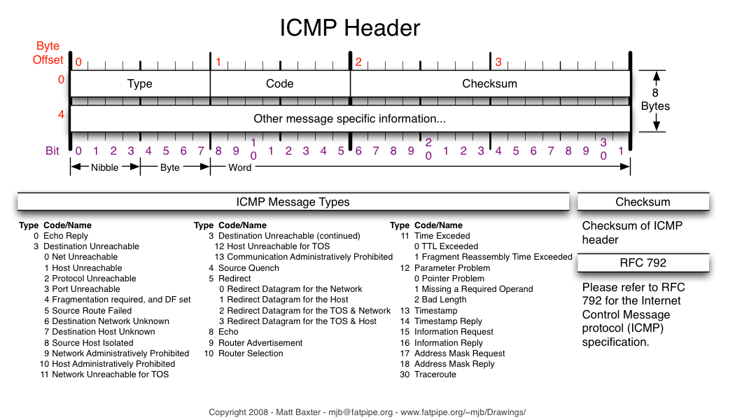
Internet Control Message Protocol

Slide 30
User Datagram Protocol - UDP
Message Oriented Transport protocol
Unreliable Datagram Protocol
Can provide Integrity Verification (Checksum of header + payload)
Simple
Stateless

Slide 31
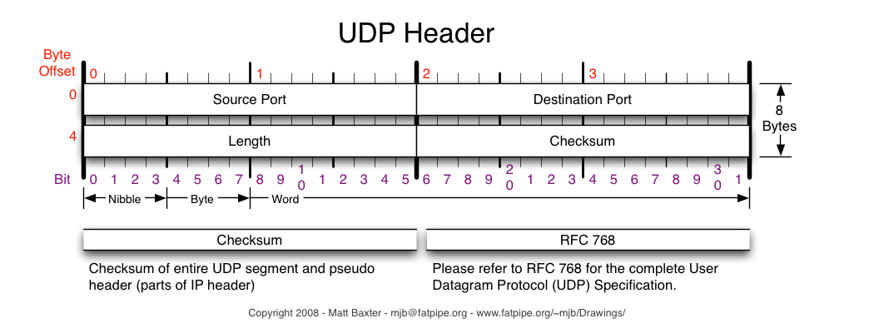

Slide 32
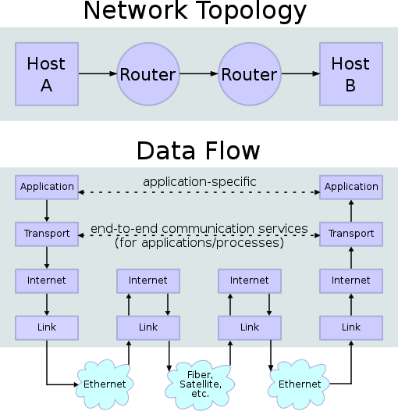
Transmission Control Protocol
Reliable, ordered and error-checked delivery of a stream of octets (bytes).
End-to-end
Full-duplex

Slide 33
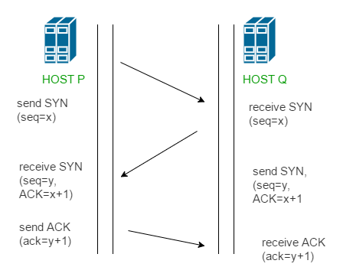
TCP Protocol Operation
Connection Establishment
Three way handshake
Data Transfer
Connection Termination

Slide 34
TCP Protocol Operation
Connection Establishment
Three way handshake
Data Transfer
Full-duplex
Connection Termination
data
…
ack
data
data
…
…
ack
ack

Slide 35
TCP Protocol Operation
Connection Establishment
Three way handshake
Data Transfer
Connection Termination
Three way handshake, in reverse.
Single side-close
s/SYN/FIN/

Slide 36
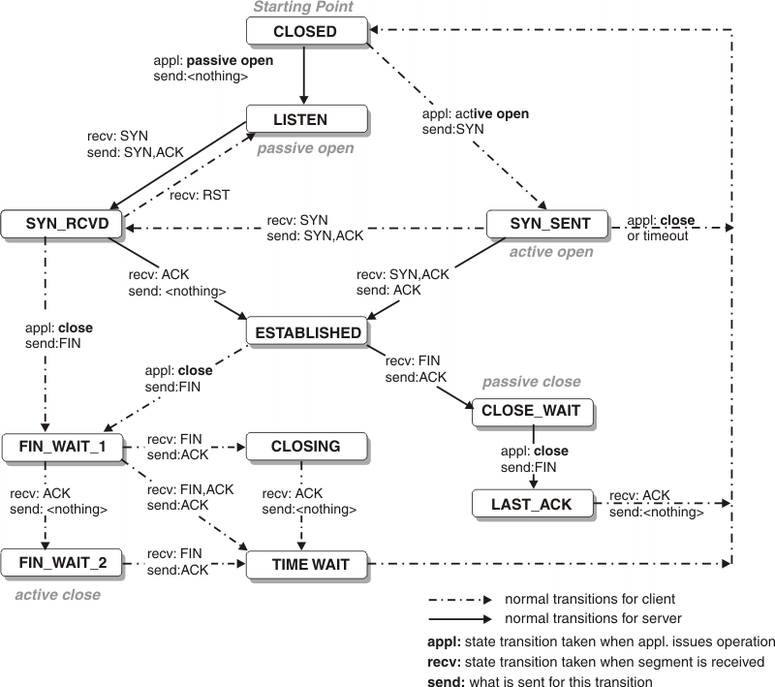
TCP state transition diagram

Slide 37
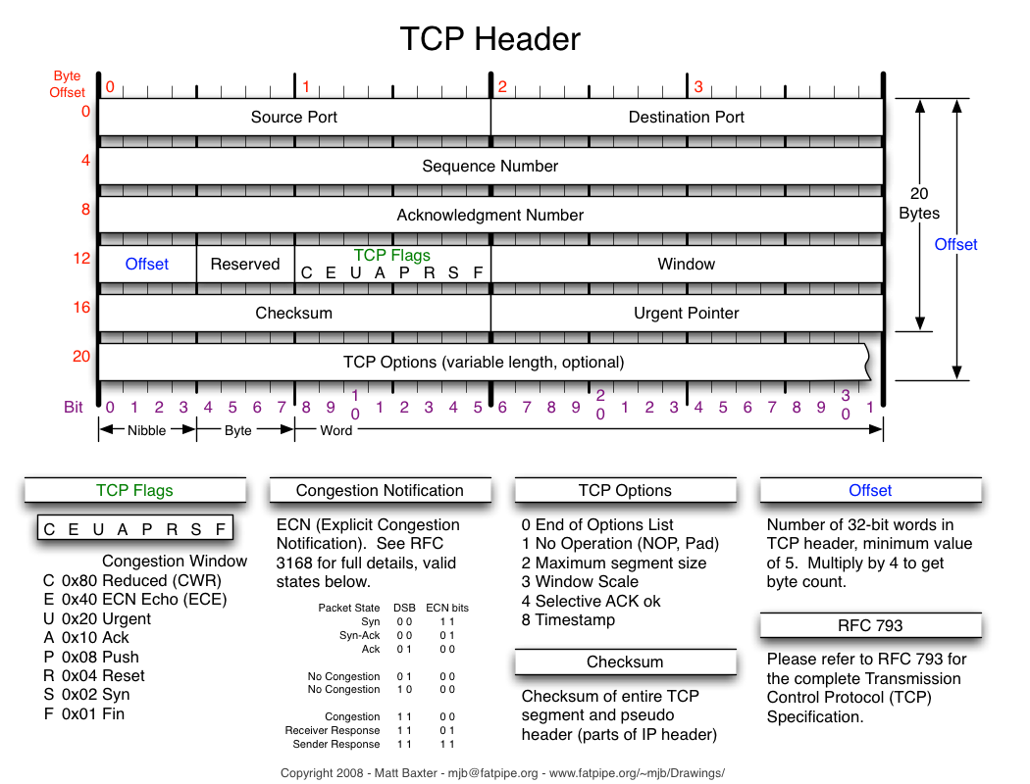

Slide 38
Summary
Overview of Networking
Host
Router
Layer 2 – 3 – Interaction
Overview of Transport protocols

